Slide 1

Predicting VIX with Adaptive Machine Learning
Yunfei Bai and Charlie Xiaowu Cai
Liverpool | Jun 2021

Slide 2
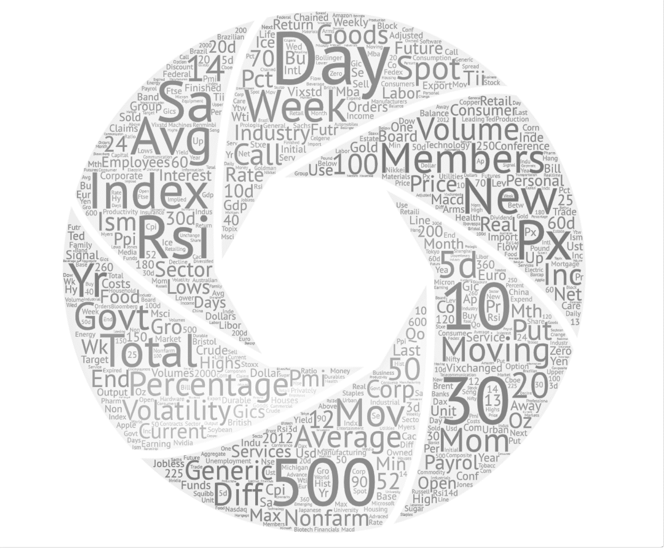
7 Algorithms
Ensemble (Ens)
Naïve Bays (NB)
Logistic Regression (LR)
Decision Tree (DT)
Random Forest (RF)
Adaptive Boosting (AB)
Neural Network (MLP)
278
Daily Directional Prediction
Research Design
Economic and Finance Variables

Slide 3
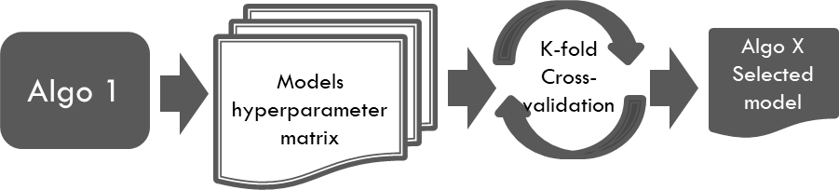

1. Training and model selection
k-fold cross-validation
With dynamic hyper parameter setting
2. Validation and algo selection
Out of sample validation
Models hyperparameter matrix
K-fold Cross-validation
Algo 1
Algo X Selected model
3. Implementation
Closed-loop continues learning
Models hyperparameter matrix
K-fold Cross-validation
Out of sample validation
Algo 2
Algo 2 Selected model
Monitor Realized Accuracy
Selected Algo X
Implement
Models hyperparameter matrix
K-fold Cross-validation
Algo N
Algo N Selected model
Data
278 features,3600 obs, 5-fold
400 obs
About 3000 obs, (11 years )
Notes:
Our ML research design consists of three key steps.
First, it is training and model section. Second, Validation and algo selection. Third, Implementation.
In the training stage, we use an Auto ML approach with hyperparameter optimization. The models are trained and selected through the k-fold validation process.
This process will produce the best performing model for each algorithm.
In the second stage, we use a set of out-of-sample data to further validate the model performance and choose a algorithm-model setup for implementation among the different algorithms.
In the implementation stage, we monitor the performance of the model performance and once the model performance is lower than a preset threshold, a retraining will be triggered. The retraining will go through the hyperparameter optimization and use updated datapoint.
This automatic and adaptive learning framework has the key advantage of producing trackable model developed with minimum human intervention. This makes the modelling approach more systematic, explainable and auditable.

Slide 4
Advantages of Auto ML + Closed looped adaptive learning
1. Efficiency
2. Reduce bias (avoid hindsight)
3. Systematic (adaptive, trackable, explainable and auditable)

Slide 5
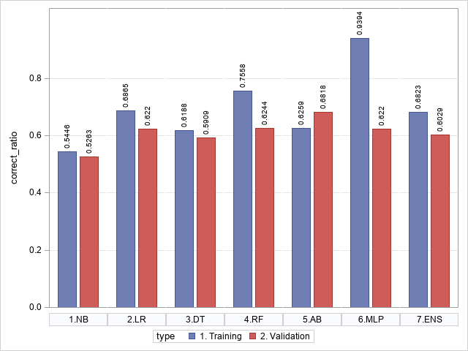


Figure 2. Training and validation accuracy for modelling at the end of 2009
(Steps 1 & 2 results)
Notes:
First more complex model perform better in-sample than simpler model as indicated by the blue bars.
The out of sample validation shows that overfitting can be a problem for the nn type model Multi-layer perceptron (MLP).

Slide 6
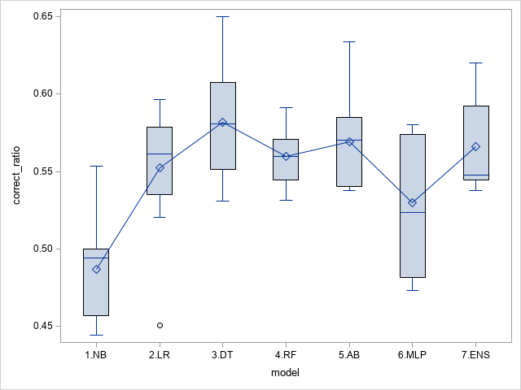



Figure 3. Out of sample implementation accuracy by model (yearly average, Step 3)

Slide 7
Table 3. Out of sample simulated ‘long-short strategy’ performance
(Size-weighted accuracy)
AB
Annualized 225%!

Slide 8
Table 13. Augmented VIX futures strategy: sitting out on conflicting days to avoid shorting pressures
AB Model Annualized 90%!
After cost

Slide 9
Source of predictability
Variable importance
Closed looped design
Balanced sampling
Multi-category predictions
Prediction persistence
Volatility Spikes

Slide 10
Contributions
VIX is predictable and the source predictability is originated from the large collection of variables and the systematic ML research design. Variables such as the weekly jobless claim and days of the week are important to the predictability which can inform future theoretical research.
3. There is a bias-variance trade-off in matching the complexity of the ML algorithm and the data generating process.
2. Contribute to automated and explainable ML. Propose a framework consists of two key components: (1) AutoML and HPO for algorithm and hyperparameter selection, and (2) performance-based closed-loop continuous learning for developing and testing out-of-sample forecasting.

Slide 11
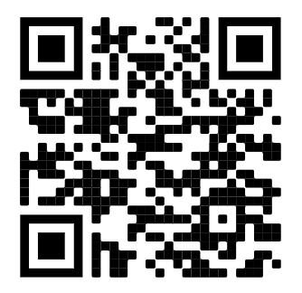
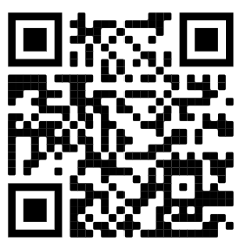
Thank you! Comments and Suggestions are most welcomed
Available at SSRN: https://ssrn.com/abstract=3866415
Available at ResearchGate: http://dx.doi.org/10.13140/RG.2.2.22245.12008

